Slide 1
Finance 101

Slide 2
PRE-AUDIT, E-VERIFY & IRAN DIVESTMENT ACT
Notes:
The last fiscal year brought some new challenges and processes. Two of these challenges were the Pre-Audit requirements and the E-Verify requirement.
About half through the year, when things were getting rejected or new vendors were not being approved….I started to get this reaction.

Slide 3
PRE-AUDIT
When is PRE-AUDIT required?
When you plan to spend county money.
Minimum threshold?
There isn’t one…any dollar amount spent must be pre-audited.
Requirements?
Finance Officer must ensure the funds are available
Finance Officer must ensure there is an appropriation authorizing obligation.
Must have the pre-audit certificate and signed by the Finance Officer
Who preforms the Pre-Audit?
Gary Groce, as the Yadkin County Finance Officer is the only person authorized to sign the pre-audit certificate.
Notes:
I think we are all used to the idea of Pre-Audit now, but lets just talk about the basic requirements so everyone has a good understanding.
When is the Pre-audit required? In you hand out it gives you all the examples of when you will need pre-audit, but to keep things simple, it is when ever and how ever you spend COUNTY dollars.
There is no minimum amount, everything must be pre-audited.
So the requirements to the pre-audit are that Lisa, must make sure there are funds available, that there is an appropriation authorizing obligation and it must has the Pre-Audit certificate and be signed by Lisa.
Lisa, is the one who must sign the pre-audit.

Slide 4
PRE-AUDIT
Process:
Finance Officer checks to see if there is an appropriation in current FY for amount due.
Finance Officer ensure there are funds remaining
Finance Officer then stamps with pre-audit certificate and signs (this is done electronically on purchase orders)
Penalties for not following the process:
The contract/agreement is VOID and cannot be enforced
ANY individual or Officer who enters into a contract/agreement without following the process may be held personally liable for the amount disbursed.
Non pre-audited purchases cannot legally be paid by the Finance Officer.
Notes:
The process is very simple, just make sure you have a Purchase order/Contract for every purchase that is made and you will be covered. This includes any procurement card and credit card transactions.
The Penalties for not following the process are found in General Statute 159-181 which is in your hand out.
Please don’t end up in the principles office!!

Slide 5

PRE-AUDIT
IMPORTANT
ALL purchase orders MUST been sent to the VENDOR
(exception of Suntrust) in order to meet the Pre-Audit
Requirement.

Slide 6
E-VERIFY (It’s Back…kind of)
G.S. 143-133.3 States:
143-133.3. E-verify compliance. (a) No board or governing body of the State, or of any institution of the State government, or of any political subdivision of the State, may enter into a contract unless the contractor, and the contractor's subcontractors under the contract, comply with the requirements of Article 2 of Chapter 64 of the General Statutes. (b) A board or governing body of the State, or of any institution of the State government, or of any political subdivision of the State, shall be deemed in compliance with this section if the contract includes a term requiring the contractor, and the contractor's subcontractors, to comply with the requirements of Article 2 of Chapter 64 of the General Statutes. (c) This section shall not apply to any of the following: (1) Expenses related to travel, including transportation and lodging, for employees, officers, agents, or members of State or local boards, commissions, committees, or councils. (2) Contracts solely for the purchase of goods, apparatus, supplies, materials, or equipment. (3) Contracts let under G.S. 143-129(e)(1), (9), or (9a). (4) Contracts let under G.S. 143-129(g). (2015-294, s. 1(a).)
Notes:
The E-verify process has been in place for a while now, and everyone is doing well with it. Just make sure that when you are requesting a new vendor that you have the E-Verify Affidavit and W-9 attached.
This leads us to the vendor information, you must have the W9 and Everify Affidavit attached to the new vendor form before it will be approved. In the past they have been approved and the finance office has called and gotten the required documentation. It is much easier on us, if you provide it.
Also before you start a contract, look to see if the company is a vendor in our system, if not start the New Vendor processes first.
And please submit the new vendor forms to the County Manager’s office as a hard copy, not email.

Slide 7
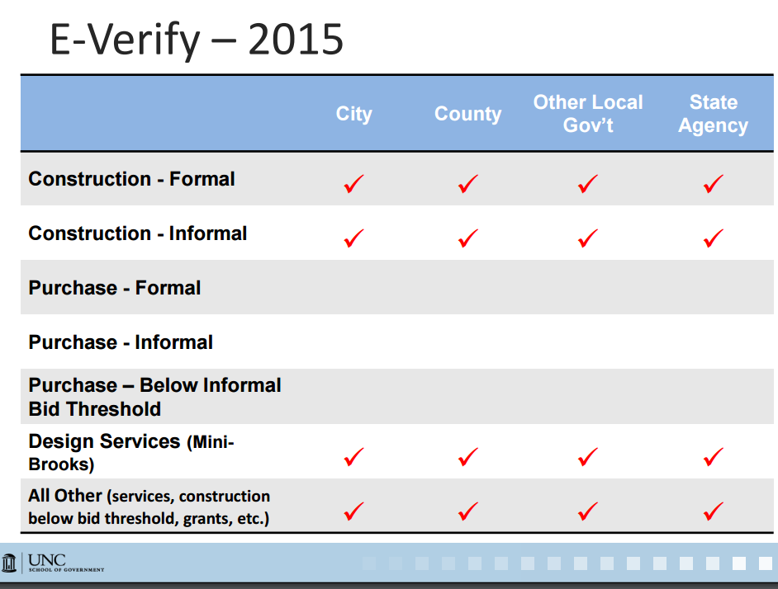

Slide 8
IRAN DIVESTMENTS ACT
Prohibits investing state funds in or contracting with entities engaged in “significant investment activities” in Iranian energy sector.
Treasurer identifies entities on the “Final Divestment List”

Slide 9

IRAN DIVESTMENT ACT
What does this mean for us?
Local Governments must require contractors to certify they are not on the list and that they will not use sub contractors who are on the list.
Applies to ALL contracts over $1000.00

Slide 10

MUNIS UPGRADE
We will be upgrading MUNS
the week of October 24th.
Please NOTE on your calendars
There will be no MUNIS access
October 24th – 28th

Slide 11
VENDOR
Must have the W-9 attached before the vendor will be approved
Needs to be submitted prior to submitting a contract/purchase requisition.
Must submit a hard copy of the new vendor form to the Finance Office.

Slide 12
BUDGET
Department Director responsibility to manage their budget.
To ensure you are staying within your budget
To monitor and ensure sufficient funds are available to continue operation.
To determine if a funds transfer or budget amendment are needed.
Notes:
Lisa -

Slide 13
BUDGET
Funds Transfer
An amount $5000.00 or less within a department can be approved by the County Manager. The applies to expenditures OR revenues.
Budget Amendments
Must be approved by the Board of Commissioners
Applies to expenditure or revenues
May NOT be submitted after JUNE 30th of each fiscal year.
Notes:
Lisa

Slide 14
ACCOUNTS PAYABLE
Need to review:
Sales tax
Invoice numbers
Invoice descriptions
Hard copies to be mailed with check
Check Run Schedule
Utilities
Fuel Receipts
Notes:
Sales Tax – open MUNIS to show how to properly use the sales tax function.
You may need to change the county that the sales tax is for. Different counties have different sales tax rates and this could be the reason that there is a difference.
Invoice numbers, it is very important that each person put the CORRECT invoice number in MUNIS, this is what the vendor use to apply payment.
Invoice descriptions, it is just as important to have a good description for referencing back in needed.
Finance will no longer print out hard copies of invoices, if you need an invoice sent with a check you must print and have to Tanya Wednesday morning.

Slide 15
PURCHASE ORDERS
Best Practices
Send to Vendor
Plan for a year
Review last years budget to get good estimates
Don’t save large purchases or projects until late in the year.
REMEMBER – ALL goods must be received by June 30th.
Change Order Form
P-Card/Credit Card Purchase Orders
A requisition needs to be entered for EACH LINE.
When turning in P-Card statements/Credit Card receipts make sure you have the Purchase Order number clearly marked.
P-Card purchases made without a purchase order will be returned to the purchaser for person reimbursement to the County.
Notes:
Planning for a year is the easiest way to use purchases order for a number of reasons, the biggest one being that you have less to keep up with.
It’s a good idea to review who you paid and how much you paid them last fiscal year, this should give you a good idea of what you need to this year.
Don’t wait until the end of the year to buy big purchases, you run into having to do funds transfers/budget amendments and may cut it close to having the goods in by June 30th.
Procurement Card purchases orders, please do purchase order PER line. This is easier for you and finance to keep up with.
Make sure you have clearly identified the Purchase order number on the receipts or statement.
PLEASE make sure before your order anything on your procurement Card/Credit card you check to make sure there is a purchase order, if not you will be liable and have to reimburse the county for the charge made.

Slide 16
CONTRACTS
When is a contract needed?
Contract Procedures
Notes:
Contracts – needed when you are purchasing a product that is customized to your department or when you have a service agreement.
Contract procedure – read off hand out.

Slide 17
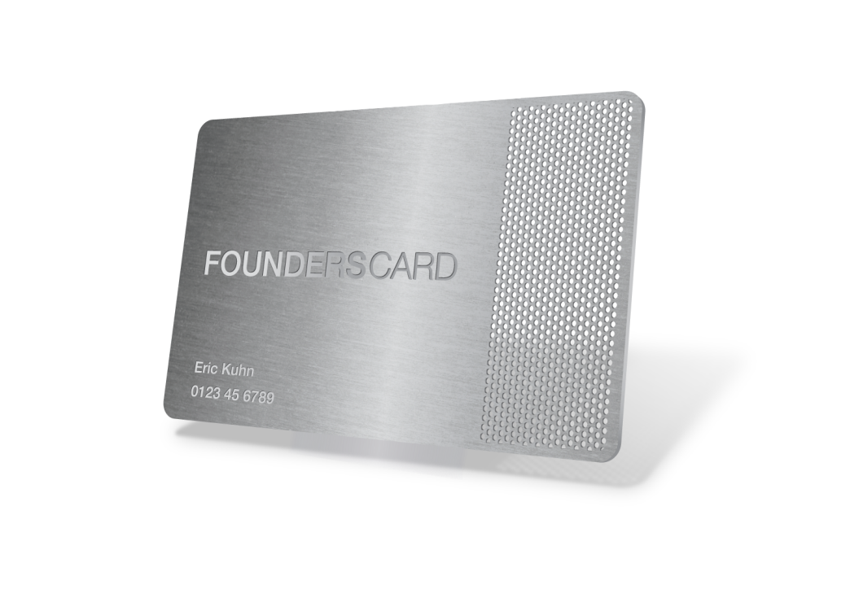
Procurement Card (P-Card)
Pre-Audit requirements
Best way to achieve the pre-audit requirement
Make all P-Card purchase order to vendor 13024 (SunTrust)
Process
Notes:
Go over the pre-audit requirements for the pcard – make sure everyone understands there must be a purchase order for the expense line.
Explain that the blanket purchase is the best way to operate.
Vendor needs to be 13024
Explain the pcard process off the handout.

Slide 18

DEPOSIT
All deposit need to be made daily and deposit receipts to the Finance Office
Must have detailed back up
Need two initials on each deposit receipt

Slide 19
FIXED ASSETS
Equipment over $5000.00
Any type of equipment or software that your department purchases that is equal to or greater than $5000.00 is considered a fixed asset.
There are object codes set up for the fixed asset accounts.
Please let Finance know when you have made a fixed asset purchase.

Slide 20
SURPLUS
Items that your department no longer needs/uses can be deemed as surplus.
You will need to fill out the GovDeals form and send to Gary, he will declare as surplus.
(It cannot be listed UNLESS it has been declared surplus)
Once declared surplus, it will then be listed on GovDeals.com. Once items have sold pick up will be arranged with the buyer.
Notes:
Go into a little more detail regarding the items, are they of value, broken etc. If so Lisa can declare then trash and the department can dispose of them.
There are different forms for office equipment, vehicles etc.
Please send pictures if possible.

Slide 21
REPORTS
YTD (Year to Date) Reports: this report will give you your account balance through the period that you specify. This does not include any invoices that are currently in a batch and have not been paid.
Invoice History by GL (Check Register): This report will give you all the invoices that have been paid in the GL Accounts and date range that you specify. It will give the invoice #’s, check #’s and date paid.
Open Purchase Order Report: This report will give you all the starting and current balances on your purchase orders and contract per expense line.

Slide 22

Employee Self Service
No Paper Timesheets
Questions
Update: October 24th-28th
Employee Self Service for ALL county staff TBA.

Slide 23

Records Management
Local Government Records retention schedule can be found at:
http://archives.ncdcr.gov/For-Government/Retention-Schedules/Local-Schedules
Verify that your department is in compliance.

